Slide 1
MIMIC III Dataset Visualization
By
Sritama Paul
AI 395T | AI In Healthcare
University of Texas at Austin
Spring 2026

Slide 2
Charts
01 | Age-Gender Population Pyramid
02 | Admission Heatmap (Day × Hour)
03 | Mortality vs Length of Stay KDE Plot
04 | Survival Chart (Kaplan Meier Style)
05 | Top Medications Administered in ICU Bar Chart
06 | ICU Length of Stay by ICU Type Box Plot
07 | ICU Length of Stay vs Age Scatter Plot

Slide 3
Initial Set Up
# Needed when you run the code in Google Colab
from google.colab import files
from datetime import datetime
import pandas as pd
import seaborn as sns
import matplotlib.pyplot as plt
import plotly.express as px
import numpy as np

Slide 4
01. Age-Gender Population Pyramid
Data used : PATIENTS.csv dataset
Steps
Calculate the patients age (filter for patients with age < 120 years)
Ages are grouped into ranges (e.g., 50–54, 55–59, …).
Count the number of Male and Female patients in each age group
A horizontal bar chart is plotted with males on one side (negative values) and females on the other.

Slide 5
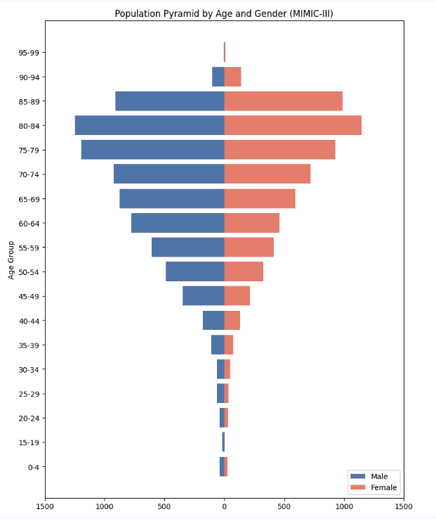
What it shows
The distribution of hospital admissions across age groups, separated by gender.
Enables direct visual comparison of male vs female representation at each age.
Helps identify demographic patterns in hospital utilization.
Useful for understanding age- and gender-specific healthcare demand and risk stratification.

Slide 6
Code for data processing
# setting up age groups (bins) for analysis and visualization
age_bins = np.arange(0, 120, 5)
age_labels = [f"{i}-{i+4}" for i in age_bins[:-1]]
patient_age_filtered_df.loc[:, "AGE_GROUP"] = pd.cut(
patient_age_filtered_df.loc[:, "PATIENTS_AGE"],
bins=age_bins,
labels=age_labels,
right=False
)
age_gender_counts = (
patient_age_filtered_df
.groupby(['AGE_GROUP', 'GENDER'], observed=True)
.size()
.unstack(fill_value=0)
.sort_index()
)
male_counts = -age_gender_counts['M'] # negative for left side
female_counts = age_gender_counts['F'] # positive for right side

Slide 7
Code for graph
fig, ax = plt.subplots(figsize=(8, 10))
ax.barh(
age_gender_counts.index,
male_counts,
color='steelblue',
label='Male'
)
ax.barh(
age_gender_counts.index,
female_counts,
color='salmon',
label='Female'
)
ax.set_xlabel('Number of Admissions')
ax.set_ylabel('Age Group')
ax.set_title('Population Pyramid by Age and Gender (MIMIC-III)')
ax.legend(loc='lower right')
# Make x-axis labels positive
ax.set_xticks(ax.get_xticks())
ax.set_xticklabels([abs(int(x)) for x in ax.get_xticks()])
plt.tight_layout()
plt.show()

Slide 8
02. Admission Heatmap (Day X Hour)
Data used : ADMISSIONS.csv dataset
Steps
Admission timestamps are extracted into day of week and hour of day.
Admissions are counted for each (day, hour) combination.
A heatmap is generated using color intensity to represent volume.

Slide 9
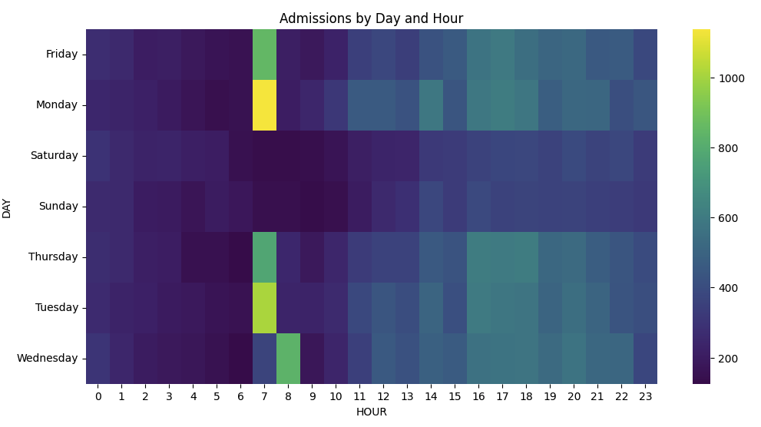
What it shows
Temporal patterns of hospital admissions across the week and throughout the day.
Highlights peak admission times.
Useful for operational planning and staffing decisions.
Reveals workload surges and off-peak periods in hospital admissions.

Slide 10
Code for data processing and graph
admissions['ADMITTIME'] = pd.to_datetime(admissions['ADMITTIME'])
admissions['HOUR'] = admissions['ADMITTIME'].dt.hour
admissions['DAY'] = admissions['ADMITTIME'].dt.day_name()
pivot = admissions.pivot_table(
index='DAY',
columns='HOUR',
values='HADM_ID',
aggfunc='count'
)
plt.figure(figsize=(12,6))
sns.heatmap(pivot, cmap='viridis')
plt.title('Admissions by Day and Hour')
plt.show()

Slide 11
03. Mortality Vs Length of Stay KDE Plot
Data used : ADMISSIONS.csv dataset
Steps
Length of stay is calculated as discharge time minus admission time (in days).
Mortality status is derived from HOSPITAL_EXPIRE_FLAG death indicators.
A density-based visualization plot (KDE Plot) based on mortality status.

Slide 12
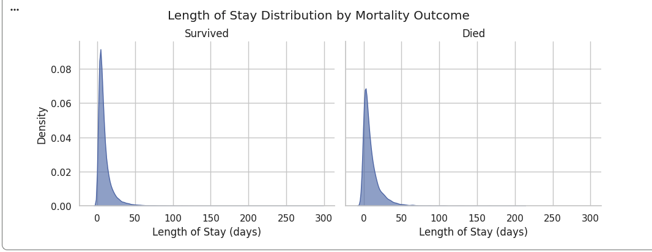
What it shows
Relationship between length of stay and patient outcomes (survival vs death).
Whether mortality is associated with very short or very long hospital stays.
Important for outcome analysis and evaluating care intensity.

Slide 13
Code for data processing
# Convert BOTH datetime columns
admissions['ADMITTIME'] = pd.to_datetime(admissions['ADMITTIME'], errors='coerce')
admissions['DISCHTIME'] = pd.to_datetime(admissions['DISCHTIME'], errors='coerce')
# Length of stay (days)
admissions['TIME_DAYS'] = (
(admissions['DISCHTIME'] - admissions['ADMITTIME'])
.dt.total_seconds() / 86400.0
)
# Event indicator: 1 = death, 0 = censored
admissions['EVENT'] = admissions['HOSPITAL_EXPIRE_FLAG']
# Remove invalid rows
admissions_filtered = admissions.loc[
admissions['TIME_DAYS'].notna() &
(admissions['TIME_DAYS'] > 0) &
admissions['EVENT'].notna()
].copy()
admissions_filtered['MORTALITY'] = admissions_filtered['HOSPITAL_EXPIRE_FLAG'].map(
{0: 'Survived', 1: 'Died'}

Slide 14
Code for graph
sns.set(style='whitegrid')
g = sns.FacetGrid(
admissions_filtered,
col='MORTALITY',
height=4,
aspect=1.2,
sharex=True,
sharey=True
)
g.map_dataframe(
sns.kdeplot,
x='TIME_DAYS',
fill=True,
alpha=0.6
)
g.set_axis_labels('Length of Stay (days)', 'Density')
g.set_titles('{col_name}')
plt.subplots_adjust(top=0.85)
g.fig.suptitle('Length of Stay Distribution by Mortality Outcome')
plt.show()

Slide 15
04. Survival Chart (Kaplan–Meier Style)
Data used : ADMISSIONS.csv dataset
Steps
Length of stay is calculated as discharge time minus admission time (in days).
Censoring is applied for patients discharged alive.
A Kaplan-Meier (K-M) survival curve (a step plot) is generated to represent survival probability over time.
Write a function to generate survival probability data over time periods

Slide 16
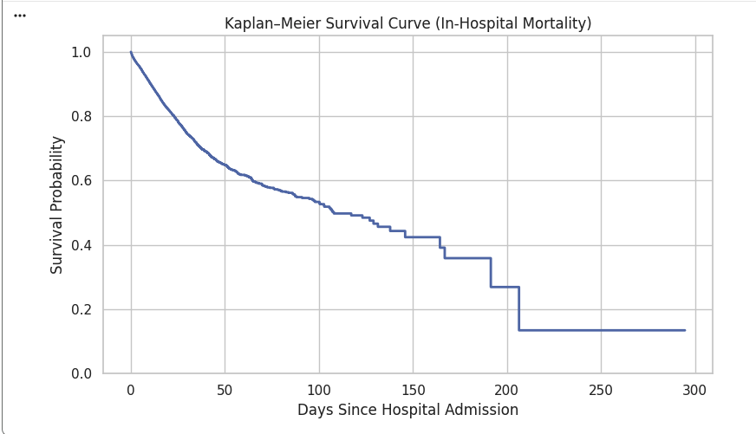
What it shows
Probability of survival as hospitalization time progresses.
Sharp drops indicate periods of higher mortality risk.
Standard method in clinical research for time-to-event analysis.

Slide 17
Code for data processing
def kaplan_meier(time, event):
df = pd.DataFrame({'time': time, 'event': event})
df = df.sort_values('time')
n_at_risk = len(df)
survival_prob = 1.0
times = [0]
survival = [1.0]
for t in np.unique(df['time']):
d = df[(df['time'] == t) & (df['event'] == 1)].shape[0]
c = df[(df['time'] == t) & (df['event'] == 0)].shape[0]
if n_at_risk > 0:
survival_prob *= (1 - d / n_at_risk)
times.append(t)
survival.append(survival_prob)
n_at_risk -= (d + c)
return times, survival
times, survival = kaplan_meier(
admissions_filtered['TIME_DAYS'].values,
admissions_filtered['EVENT'].values
)

Slide 18
Code for graph
plt.figure(figsize=(8,5))
plt.step(
times,
survival,
where='post',
linewidth=2
)
plt.xlabel('Days Since Hospital Admission')
plt.ylabel('Survival Probability')
plt.title('Kaplan–Meier Survival Curve (In-Hospital Mortality)')
plt.ylim(0, 1.05)
plt.grid(True)
plt.tight_layout()
plt.show()

Slide 19
05. Top Medications Administered in ICU Bar Chart
Data used : ICUSTAYS.csv,
PRESCRIPTIONS.csv dataset
Steps
Medication administration records are filtered to ICU stays..
Medication names are counted by frequency.
A bar chart displays the most commonly administered drugs.

Slide 20
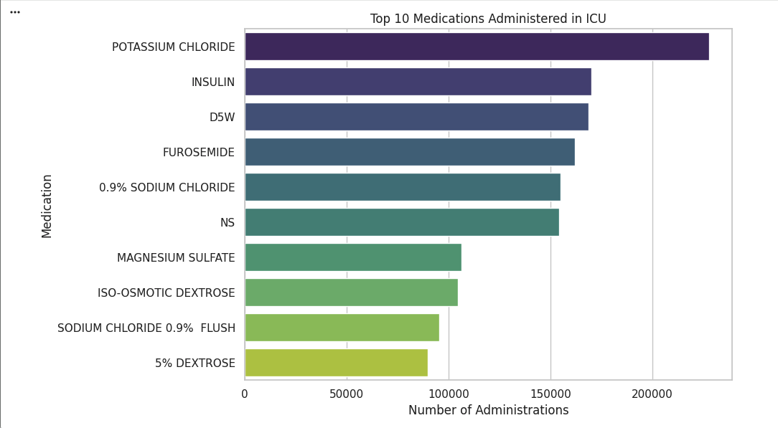
What it shows
The medications most frequently used in ICU settings.
Reflects common treatment protocols.
Helps understand ICU clinical practices.
Useful for resource planning, pharmacy inventory, and clinical research.

Slide 21
Code for data processing
# Merge prescriptions with ICU stays
icu_rx = prescriptions.merge(
icu_stays[['SUBJECT_ID', 'HADM_ID']],
on=['SUBJECT_ID', 'HADM_ID'],
how='inner’
)
# Normalize medication names
icu_rx['DRUG'] = (
icu_rx['DRUG']
.str.upper()
.str.strip()
)
icu_rx = icu_rx[icu_rx['DRUG'].notna()]
# Top medications
top_meds = (
icu_rx['DRUG']
.value_counts()
.head(10)
.reset_index()
)
top_meds.columns = ['Medication', 'Count']

Slide 22
Code for graph
plt.figure(figsize=(10,6))
sns.barplot(
data=top_meds,
y='Medication',
x='Count',
palette='viridis',
hue='Medication',
legend=False
)
plt.title('Top 10 Medications Administered in ICU')
plt.xlabel('Number of Administrations')
plt.ylabel('Medication')
plt.tight_layout()
plt.show()

Slide 23
06. ICU Length of Stay by ICU Type Box Plot
Data used : ICUSTAYS.csv dataset
Steps
ICU stay durations are calculated for each ICU admission.
Data is grouped by ICU type (e.g., MICU, SICU, CCU).
Boxplots are used to show ICU stay distributions.

Slide 24
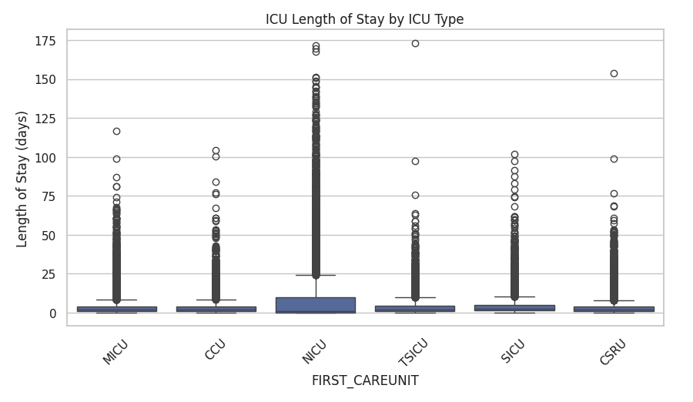
What it shows
Variation in Length of Stay across different ICU units.
Median stays, variability, and outliers by ICU type.
Highlights differences in case severity and care complexity.
Useful for ICU performance evaluation and capacity planning.

Slide 25
Code for graph
plt.figure(figsize=(10,5))
sns.boxplot(
data=icu_stays,
x='FIRST_CAREUNIT',
y='LOS_DAYS'
)
plt.xticks(rotation=45)
plt.title('ICU Length of Stay by ICU Type')
plt.ylabel('Length of Stay (days)')
plt.show()

Slide 26
07. ICU Length of Stay vs Age Scatter Plot
Data used : ICUSTAYS.csv dataset
Steps
Patient age is plotted against ICU Length of stay.
Scatter plots or smoothed trend lines are used.

Slide 27
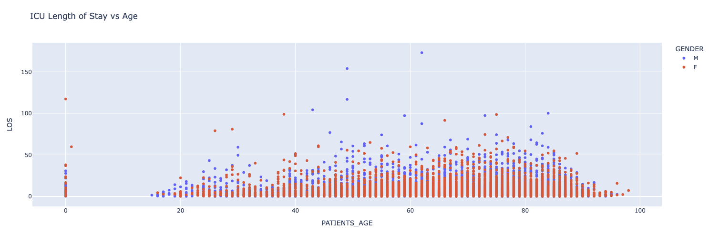
What it shows
Relationship between patient age and ICU stay duration.
Whether older patients tend to have longer or more variable ICU stays.
Helps assess how age impacts resource utilization.

Slide 28
Code for data processing
# Merge admissions and patients data on subject_id
merged_patients_admission_data = pd.merge(admissions, patient_age_filtered_df, on="SUBJECT_ID")
#merged_patients_admission_data.head()
merged_patients_admission_data.info()
df_los = merged_patients_admission_data.merge(icu_stays, on=['SUBJECT_ID', 'HADM_ID'])

Slide 29
Code for graph
fig = px.scatter(
df_los,
x='PATIENTS_AGE',
y='LOS',
color='GENDER',
title='ICU Length of Stay vs Age'
)
fig.show()

